Slide 1
S.C.O.R.E
Milestone 3
Notes:
Michael

Slide 2
Team
Charlie Collins
Tommy Gingerelli
Logan Klaproth
Michael Komar
Faculty Advisor/Client
Dr. Mohan
Notes:
Michael

Slide 3
Milestone 3
Implement the client server application
Implement file transfer
Implement auto testing
Implement feedback system
Notes:
Michael

Slide 4
Milestone 2 - Completion Matrix
Task | Completion | Charlie | Logan | Michael | Tommy | To Do
Implement Client Server Interaction | 90% | 40% | 0% | 60% | 0% | Implement a man page and more robust responses
Implement File Transfer | 75% | 60% | 0% | 40% | 0% | Implement an sftp server to properly handle the file transfers
Implement Auto Testing | 80% | 0% | 50% | 0% | 50% | Auto Test caller, output comparisons, locating files
Implement Feedback System | 50% | 0% | 50% | 0% | 50% | Implement professor-provided feedback
Notes:
Michael

Slide 5
Implement Client Server Interaction

Slide 6
Client-Server - Completed
Previously the shell was a single application
Now is split into a client and server
Communicate through TCP
Server is asynchronous and uses threads to handle multiple clients

Slide 7
Client-Server - Completed
Client
Server
Run locally on the users machine
Ideally on code01
Any SCORE command will be sent to the server
If the arguments are not given, they are prompted for
Any non SCORE command is executed locally on bash
Creates a thread for each client connection
When a command is received, calls the associated module
Sends a response back to the client when done

Slide 8
Client-Server - TODO
More verbose responses
Currently just responds with a success or failure message
For failures, we want it to provide reasoning as to why
Create a man page
Make SCORE easier to use

Slide 9
Implement File Transfer

Slide 10
File Transfer - Completed
Upon calling “submit”, the client transfer all files
SFTP
These files are transferred to a temporary directory on the server
The submit module on the server will then handle the files

Slide 11
File Transfer - TODO
Currently the files are transferred directly to a directory on the server
Need a way to manage the incoming files
Ensure that no files are overwritten by other files

Slide 12
Implement Auto Testing

Slide 13
Auto Testing - Completed
Startup and removal of testing environment
Dockerfile is modified according to assignment
Docker image is built from a dockerfile
Container is spun up for test and torn down after
Image is removed after testing concludes
Run file on testing environment
Input files copied onto docker image
Submission is run for every input file
File location is currently static
Output log taken from docker

Slide 14
Auto Testing - TODO
Update file paths on dockerfile
Take in arguments for different submissions
Comparing output to test cases
Scheduling the testing script
Implement “Verification” Program

Slide 15
Feedback System

Slide 16
Feedback System - Completed
Based on auto-testing results of an assignment, the feedback that is generated is a printout of the number of test cases passed vs failed.

Slide 17
Feedback System - TODO
Add potential wait times for submission feedback.
Add professor guided feedback based upon auto testing results.

Slide 18
System Architecture

Slide 19
System Architecture - Completed
Python “Thread Manager”
Manages 3 sub processes programs.
Wakes sub processes when not needed.
Handles all communications between front end and back end.
Auto Test Runner
Receives submissions to test from Thread Manager.
Creates a thread of the autotest.py
Runs X tests against the submission.
Returns test results.
Returns test results to thread manager.
Kills completed child threads
Auto Feedback
Receive submission with test results.
Currently returns test results.

Slide 20
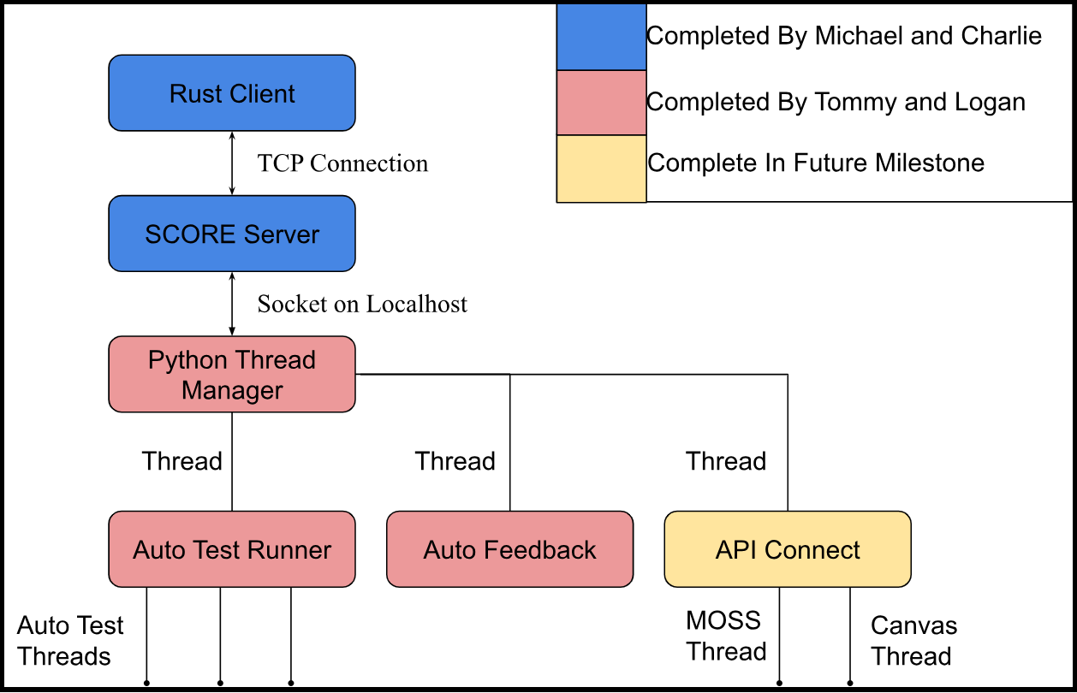
System Architecture - Diagram

Slide 21
System Architecture - TODO
Python “Thread Manager”
Management of API Connect thread
API Connect
Create file
Allow for connection between external API and system.
Auto Feedback
Improve user feedback with targeted professor feedback.
Report errors as different than just test case failures.
Report error types and implement common reasons for certain error types.
Web UI
Connect with Socket.

Slide 22
Milestone 4
Task | Charlie | Logan | Michael | Tommy
Finish auto testing and feedback | 0% | 50% | 0% | 50%
Develop front end of web app | 15% | 35% | 35% | 15%
Implement user authentication | 20% | 20% | 30% | 40%
Integrate server components | 50% | 0% | 50% | 0%

